Slide 1
Citizen Engagement in Science – why, how and when?
Tuesday 24th June 2014
Copenhagen Business School
Led by Rhonda Smith, Director, Minerva UK

Slide 2
Agenda
Welcome & introductions
What experience do you have of ‘citizen engagement’?
Citizen Engagement – why?
Break
Citizen Engagement – how?
Citizen science
Social media
Science fairs
Citizen Engagement – when?
Q&A

Slide 3
Citizen engagement – who needs science?
Everyone!
“Science literacy” – making sense of the world around us
Understanding human health
Sustainable food for the future
Energy
Science increasingly plays a part in our everyday lives
Many policy debates centre on scientific questions – how can we make informed decisions?

Slide 4
Watch this video of trainee teachers and scientists answering the question – why is science important?
http://youtu.be/9fGxccEamyM

Slide 5
Citizen engagement – the stats
On the whole, Europeans have a positive view about the image of science and technology but appear to have less clear insight into the work of the scientist.
30% of Europeans are “very interested” in new scientific discoveries and technological developments (49% are moderately interested)
50% feel moderately informed about new scientific discoveries and technological developments, with few feeling very well informed (11%)
Source: Eurobarometer 2010
26,671 interviews in 32 countries

Slide 6
Europeans feel that scientists should take decisions about science but the public should be consulted.
Most feel that scientists should communicate about science … but are not very efficient in doing so!
Many are not clear about the current level of EU investment in research but feel that an increase in such investment would be beneficial.
People who are interested in/informed about new scientific discoveries are much more likely to have a positive view of science and technology.
Source: Eurobarometer 2010
26,671 interviews in 32 countries

Slide 7
The red bars show how many think it is important to know about science…
Notes:
… so citizens think science is interesting & important!
The red bars represent those who think it is important to know about science…

Slide 8
Citizen engagement – benefits for citizens
Engagement gives people the opportunity to explore the meaning of research and shape research agendas.
Public funding means society has a right to shape research agendas and be involved in decisions about how discoveries are used.
It an effective way of stimulating interest in a subject and encouraging young people to consider research careers.
Source:
Economic & Social Research Council

Slide 9
Citizen engagement – benefits for you
Shape your research agenda so that it is more meaningful, useful and likely to have more impact.
Help develop your methodologies and ensure you are asking the most useful questions.
Early engagement can make it easier to recruit focus group participants or survey respondents.
Raise your profile and help you develop new skills. It’s challenging…
…but it can be fun!
Source:
Economic & Social Research Council

Slide 10
Citizen engagement – why now?
Cost of transmitting/receiving information is reduced.
We have the time to do it (UK households spend 4hrs on average watching TV every day & 1.5hrs online*).
The world has ‘big problems’ to solve – which can’t be fixed by one person or discipline alone.
*Source: Ofcom Survey 2013

Slide 11
Citizen engagement – in summary:
Communication =
effective engagement with
Policymakers
Individuals/Public
Industry
Media

Slide 12
Citizen engagement in science can be…
“scientific research conducted, in whole or in part, by amateur or non-professional scientists, often by crowdsourcing”
Advantage 2: Error-checking in collected data
Advantage 1: Capacity to do more work

Slide 13
Watch these 3 examples of citizen science projects.
Which video engages you? Which has the most impact? Why?
Children transcribe ancient papyrus text - http://youtu.be/pX514ma6KoA
2. Community gardens in Croatia – http://youtu.be/QY3q7RpU6_4
3. Planetary habitats (NASA) - http://youtu.be/ww6bVWk7TLY

Slide 14
Citizen engagement – how?
First, think about what you are trying to achieve – you’ll need a communication strategy to ensure your activity gets the right results.
Identify your key message/audience:
What do I want to say?
Why do I need to say it?
Who needs to hear it?
Example:
What do I want to say? EU legislation must change
Why do I need to say it? To enable production & processing
Who needs to hear it? Regulators (DG Sanco) & legislators (EP)

Slide 15
Three key ways to communicate:
VISUAL
PERSONAL
VISUAL
PERSONAL
INTERACTIVE

Slide 16
You can communicate using a huge variety of visual media:
Photographs
Posters
Videos - http://youtu.be/rsZ1KfPZUvM
Animation
VISUAL
PERSONAL

Slide 17
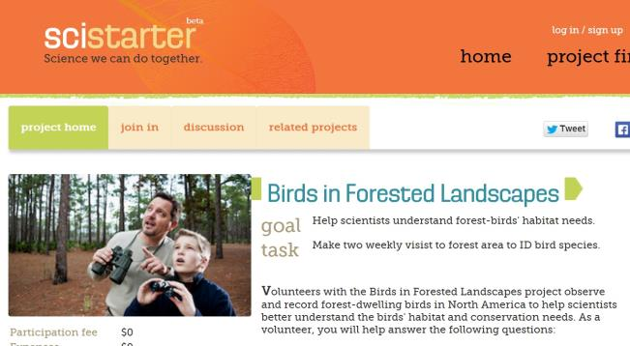
Involving your audience will encourage greater engagement.
Surveys
Quizzes and games
‘Citizen Science’
INTERACTIVE
VISUAL

Slide 18
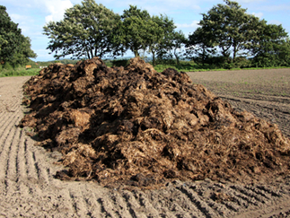
Substrate used to rear insects
Insect larvae to be processed for use in animal feed can be raised on a range of waste materials listed below. Tick the waste materials you think are suitable to be used.
Example of a project survey designed to gauge consumer acceptance

Slide 19
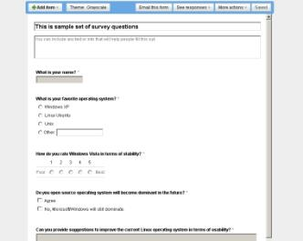
Can you create your own survey or quiz?
Write a few questions for a survey or quiz based on your project.
What are you interested in finding out?
What are you going to do with it? (the survey AND the results!)

Slide 20
PERSONAL
What is the human experience or impact of your project?
Make it personal!

Slide 21
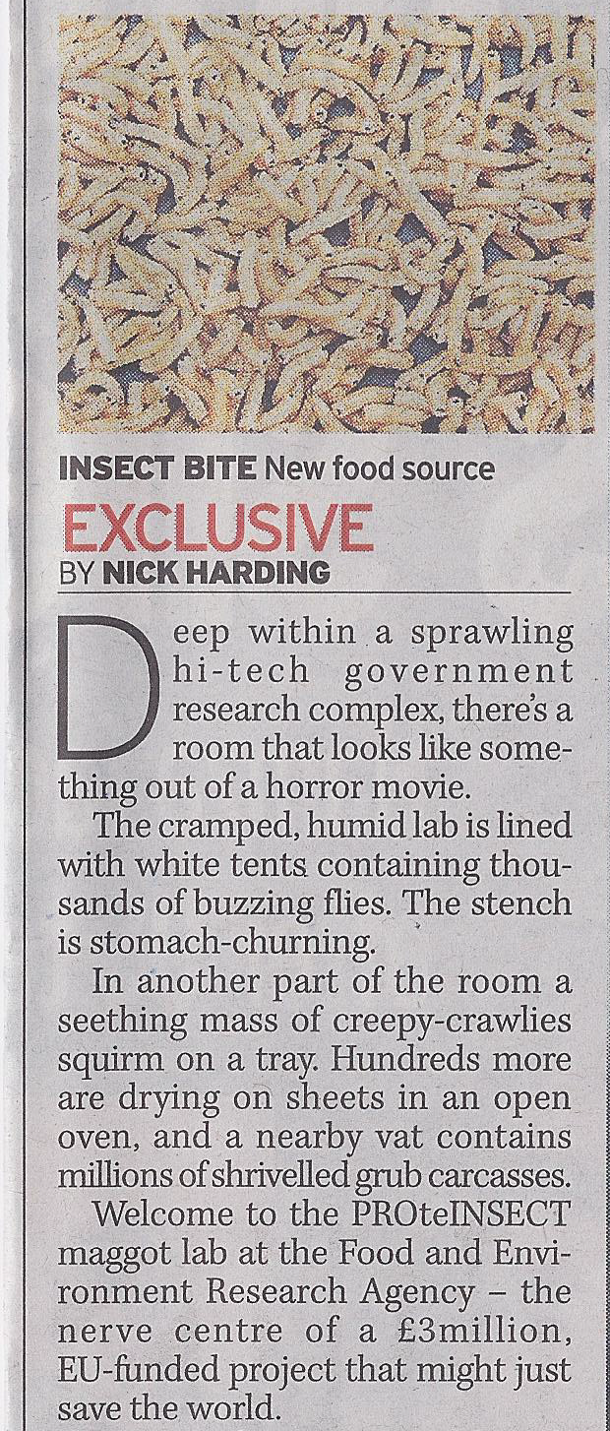
Storytelling…
Journalists are always looking for a good story.
Every research project has a story to tell!
A beginning – the hypothesis
A middle – the method
An end – the results

Slide 22
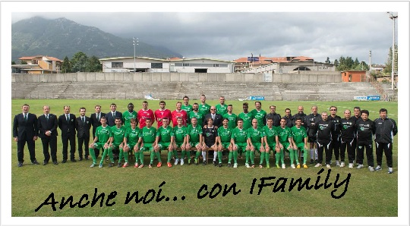
Citizen engagement – partnerships
In Italy, the I.Family study – an EU project investigating healthy lifestyles in European families – has created a partnership with a local football team, FC Avellino.
One classroom from each participating school has a chance to win match tickets. The more children take part in I.Family, the greater the chance of winning!
Can you create a local partnership to encourage citizen engagement?

Slide 23
Citizen engagement – social media
Which platform? That depends on your strategy!
Are you seeking opinion?
Do you want to invite feedback, or spark a discussion?
Are you raising awareness?
Do you have a striking image?
Project website
Project website
Poster presentation
Project website
Poster presentation
Project website

Slide 24
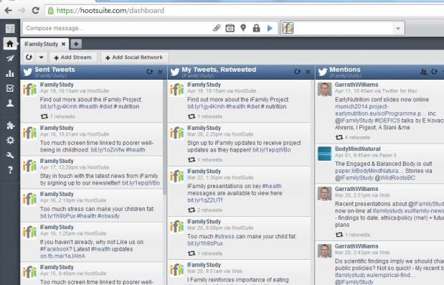
It only takes a few minutes to set up free accounts to represent your project online…
… you can monitor, manage and analyse multiple accounts simultaneously – saving you time and ensuring your communication activity is effectively targeted. Look at Hootsuite and Bufferapp!
Don’t forget to cross-promote your project across different accounts!

Slide 25
Example of a project Facebook page – drive people back to your website

Slide 26
Example of a project Twitter account – keep the conversation going, aim for ‘quality’ followers

Slide 27
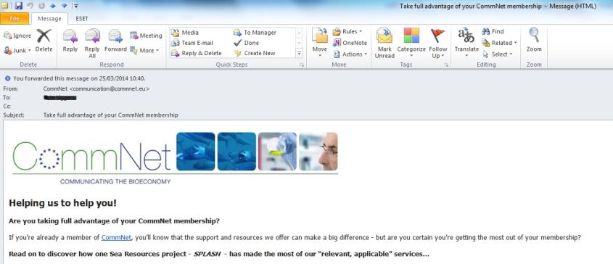
It’s a good idea to build up a database of key contacts. Make a note of anyone you meet who may have ongoing interest in your work.
You can keep them updated with your project’s latest news and developments for free by issuing regular newsletters or e-zines.
This will cost you nothing but time!

Slide 28
Citizen engagement – Science Fairs
ESOF – Science in the City
American Society for Advancement of Science – biggest in the world!
The Festival of Curiosity (UK/Ireland Science Gallery) – recruit citizen volunteers to help staff the exhibition
“I’m a scientist get me out of here” - http://youtu.be/b0y8Dyj_OSc

Slide 29
Remember…
Citizen engagement is not just about young people!
The older generation has the time and enthusiasm to ‘do science’.
Watch this video about a ‘Senior University’ run by Socientize.
Visit the Socientize website for more details (see next slide).
http://youtu.be/TECu-3V6QaE

Slide 31
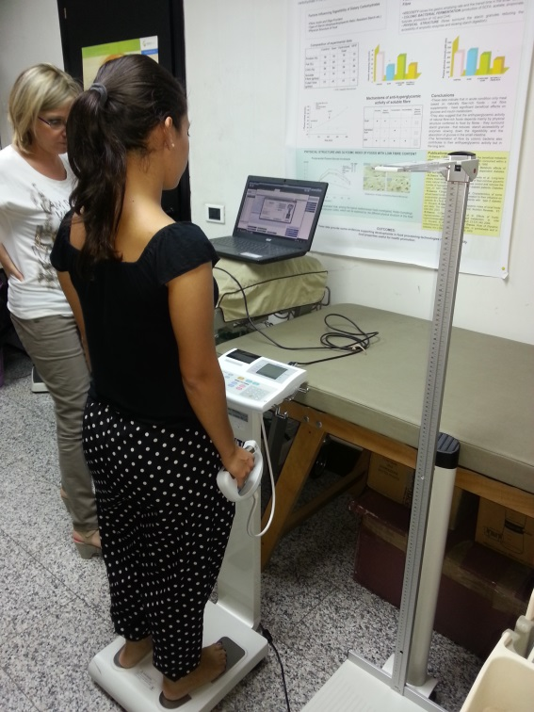
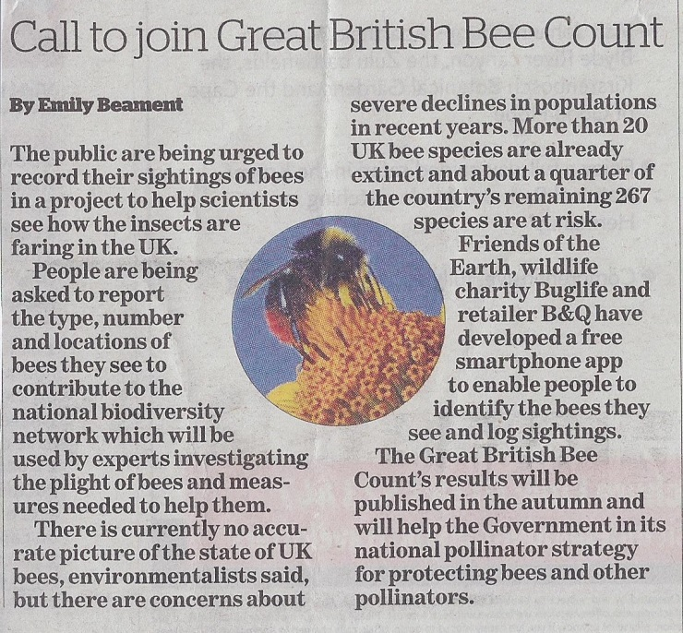
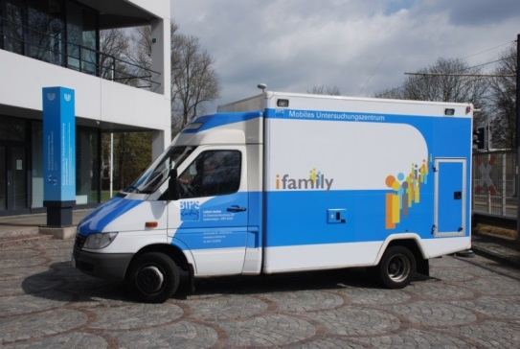
Citizen engagement – when?
Online/on your website
Conferences & events
Through media coverage
Local partnerships
In the community

Slide 32
Citizen engagement – creating impact
A ‘test’ bed – identifying perceptions
Gathering opinion
Gathering data:
- Microb3 - http://youtu.be/FEw5AS1qo-o
Refining & amending
Validation
It’s a game changer!

Slide 33
“Collective intelligence to solve global challenges”
Think global … Act local!

Slide 34
Citizen engagement – next steps
Are you equipped to
Inform?
Consult?
Collaborate?
Find out!
Have a go at our self-assessment tool. Download from the Minerva website

Slide 35
Thank you
We hope you have enjoyed the Masterclass

